Slide 1
Big Data with Apache Spark and Java
Analyze huge amount of data in Distributed manner
Nikki Yodo

Slide 2
Introduction
Experience: Software, DevOps, Cloud Ops engineer
GitHub: https://github.com/nik-yo
LinkedIn: https://www.linkedin.com/in/nikkiyodo/
Consulting: www.nikyotech.com
Email: nikki.yodo@nikyotech.com

Slide 3
What is Apache Spark?
Apache Spark™ is a multi-language engine for executing data engineering, data science, and machine learning on single-node machines or clusters. (https://spark.apache.org/)
Distributed system that enables processing of huge amount of data.
Written in Scala.
Products:
Amazon EMR
Azure Synapse Analytics
Databricks

Slide 4
Supported OOB
File format: csv, json, etc.
Compression: zip, gzip, etc.
Language: Scala, Python, Java, SQL, etc.
Execution Method:
Interactive Shell (Python, Scala)
Self-contained application (Python, Scala, Java)
REST API (Apache Lyvi)

Slide 5
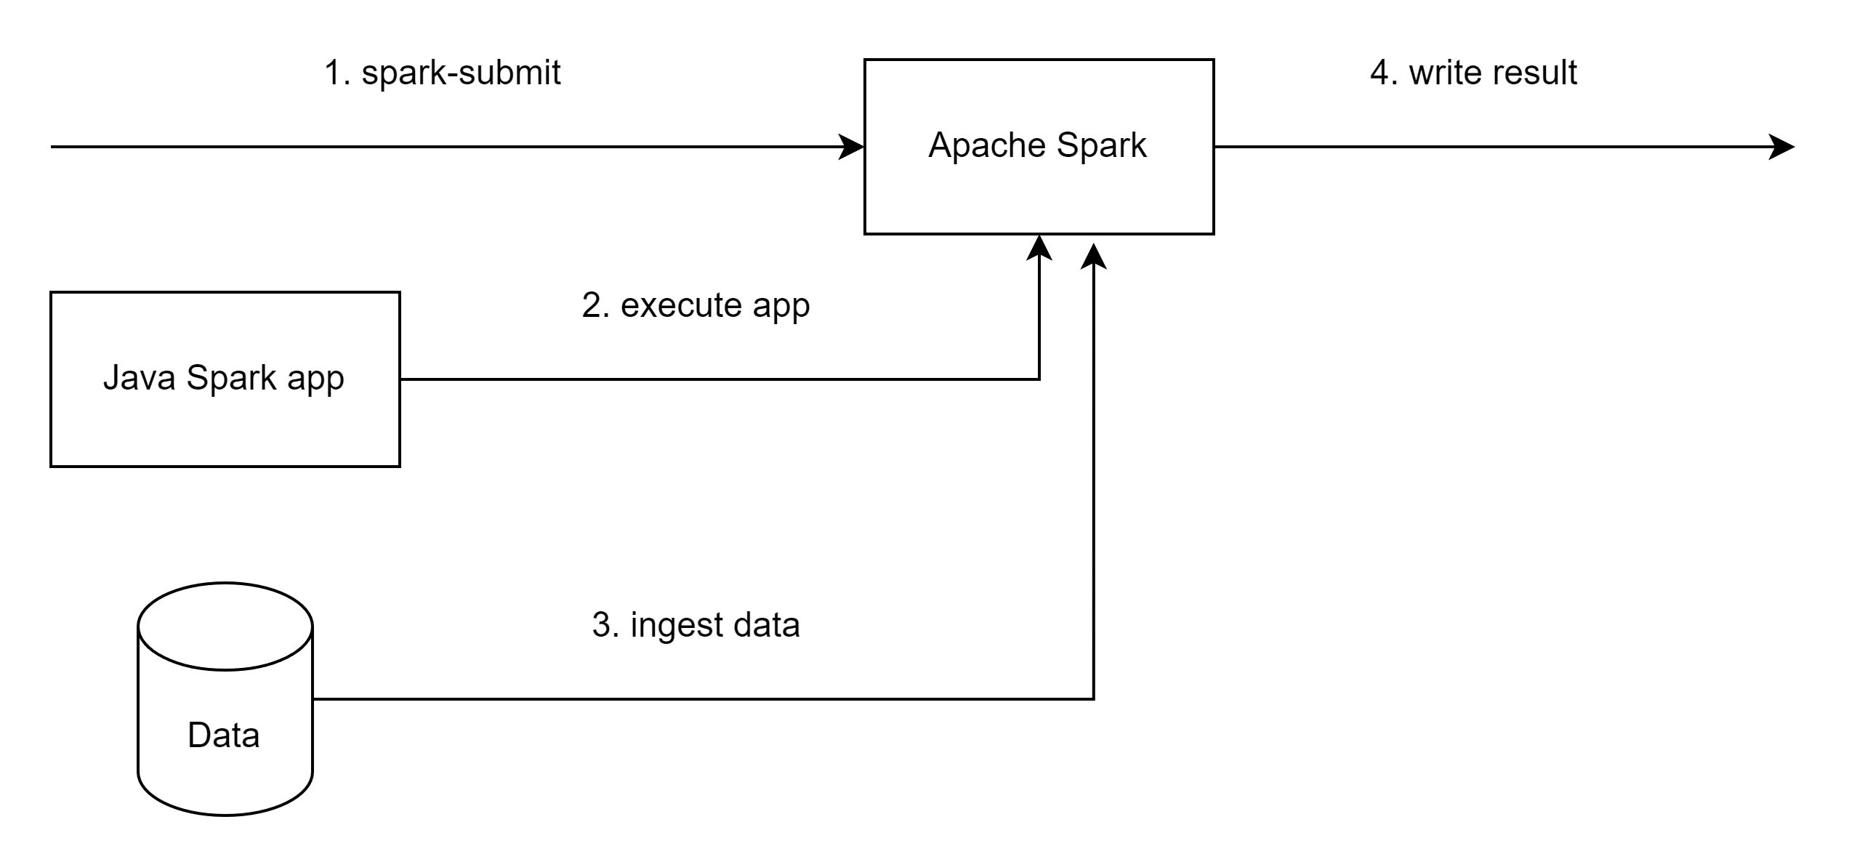
Execution Diagram

Slide 6
Demo
Show schema
Count rows
Get unique values
Aggregate
Export

Slide 7
Questions?

Slide 8
Local Stack
Windows 11 + WSL
Java 17 (AWS Corretto)
Intellij IDEA + Maven
Docker Desktop
Bitnami Spark

Slide 9
Use Cases
ETL
Obfuscation
Analytics

